Slide 1
Robust Designs|Optimization
& Applications
Dr. İhsan Yanıkoğlu

Slide 2
Historical Landmarks

Slide 3
History of IE
1760-1800’s: Industrial Revolution
The Industrial Revolution was the transition to new manufacturing processes in the period from about 1760 to sometime between 1820 and 1840.
This transition included going from hand production methods to machines, new chemical manufacturing and iron production processes, improved efficiency of water power, the increasing use of steam power, and the development of machine tools.
It also included the change from wood and other bio-fuels to coal and petroleum.

Slide 4
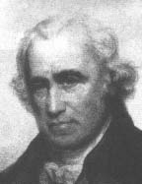

1736 - 1819: James Watt
Watt’s Steam Engine

Slide 5
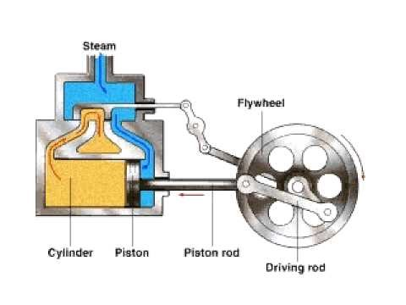

Slide 6
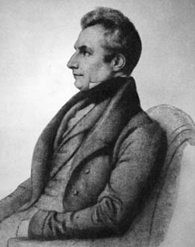
1791 - 1871: Charles Babbage
A self-made mathematician
Observed factory operations systematically.
Analyzed the effects of labour division and organization.
  Division of Labor: the assignment of different parts of a manufacturing process or task to different people in order to improve efficiency.
Father of computer.
Book: On the Economy of Machinery and Manufactures (1832)

Slide 7
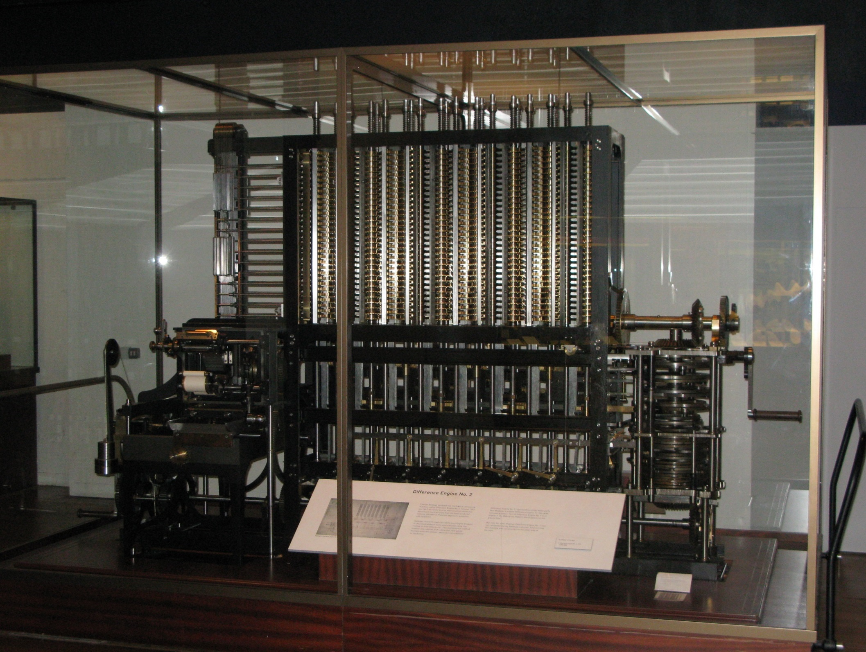

Slide 8
Precursor of IE – Armory Practice
Manufacturing methods in 19th century:
The two notable features were extensive use of interchangeable parts and extensive use of mechanization to produce military equipments, which resulted in more efficient use of labor compared to hand methods. The system was also known as armory practice.

Slide 9


Historical Landmark
Design of machines that can be operated by labor with minimal training
Mass production: production of large amounts of standardized products, especially on assembly lines
Interchangeable components

Slide 10
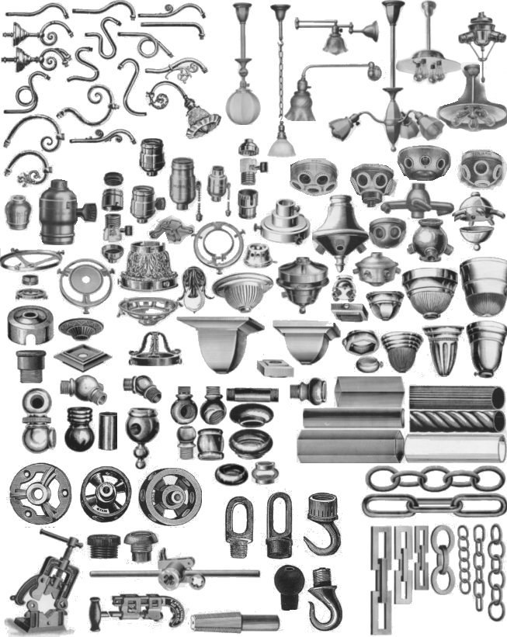

Slide 11
History of IE- Historical Landmarks
The foundations of industrial engineering as it looks today, began to be built in the twentieth century.
The first half of the century was characterized by an emphasis on increasing efficiency and reducing industrial organizations’ costs.
In 1909, Frederick Taylor published his theory of scientific management (Taylorism).

Slide 12
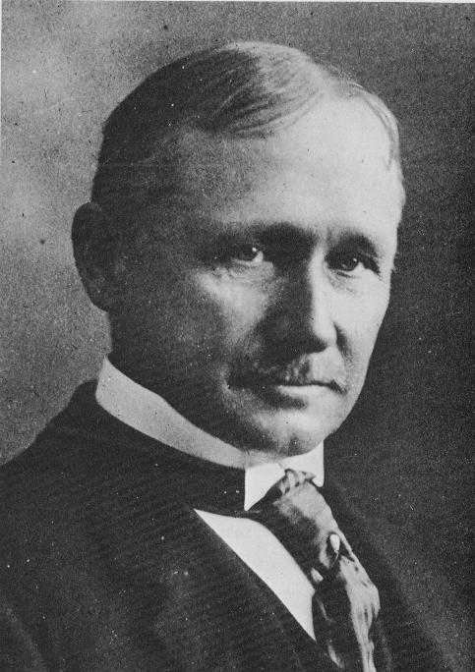
History of IE- Historical Landmarks
1856 - 1915: Frederick Taylor
‘‘Father’’ of industrial engineering
He recognized the potential improvements to be gained through analyzing the work content of a job.
His goal is to design the job for maximum efficiency and productivity.
Introduced the concept of Scientific Management.

Slide 13
History of IE- Historical Landmarks
Scientific Management:
Analysis; synthesis;
logic; rationality; empiricism; work ethic;
efficiency; elimination of waste; standardization;
craft production ➔ mass production;
knowledge transfer.

Slide 14
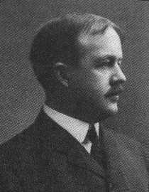
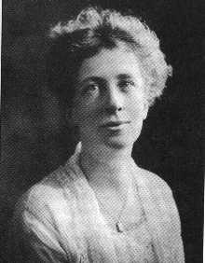
History of IE- Historical Landmarks
1868 - 1924: Frank Gilbreth
Time and Motion Study
Measurement of each basic motion to perform a job
They considerably extended Taylor’s work.
They developed foundational concepts of IE.
Frank and Lillian Gilbreth

Slide 15
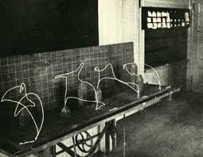
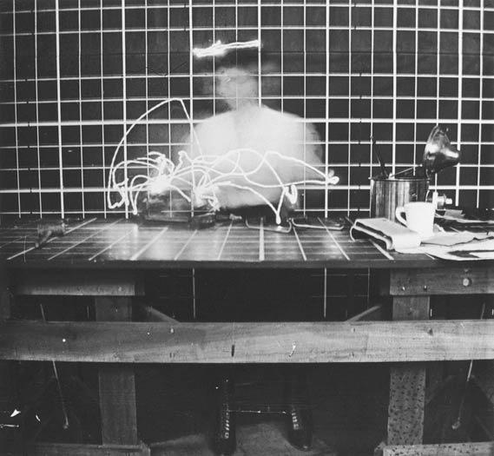
Motion Study

Slide 16
Brick Laying Motion Study

Slide 17
Full Gilbreth’s Movie

Slide 18
History of IE- Historical Landmarks
Late 19th century: The idea of consulting with experts about process engineering naturally evolved into the idea of teaching the concepts as curriculum.
Industrial engineering courses were taught by multiple universities in Europe at the end of the 19th century, including in Germany, France, the United Kingdom, and Spain. In the United States, the first department of industrial and manufacturing engineering was established in 1909 at Penn. State Uni. The first doctoral degree in industrial engineering was awarded in the 1930s by Cornell Uni.

Slide 19
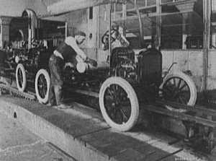
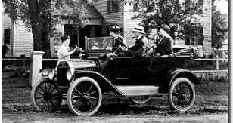
1863 - 1947: Henry Ford
1913: He installed the first conveyor belt-based assembly line in his car factory
Ford Model T
assembled in 93 minutes
Assembly Line at Ford

Slide 21
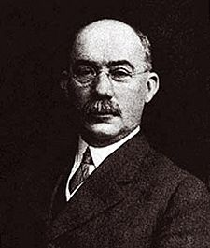
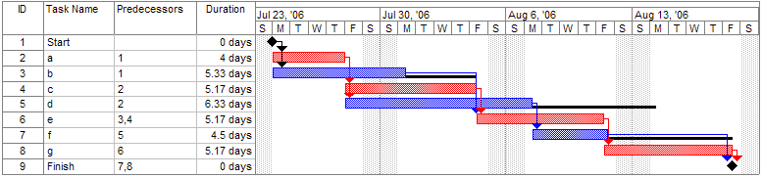
1912: Henry L. Gantt
Developed the Gantt chart in 1912.
Father of ‘‘project management’’
The Gantt is a systematic graphical procedure for preplanning and scheduling work activities, reviewing progress, and updating the schedule.
The Gantt chart is still widely used today.

Slide 22
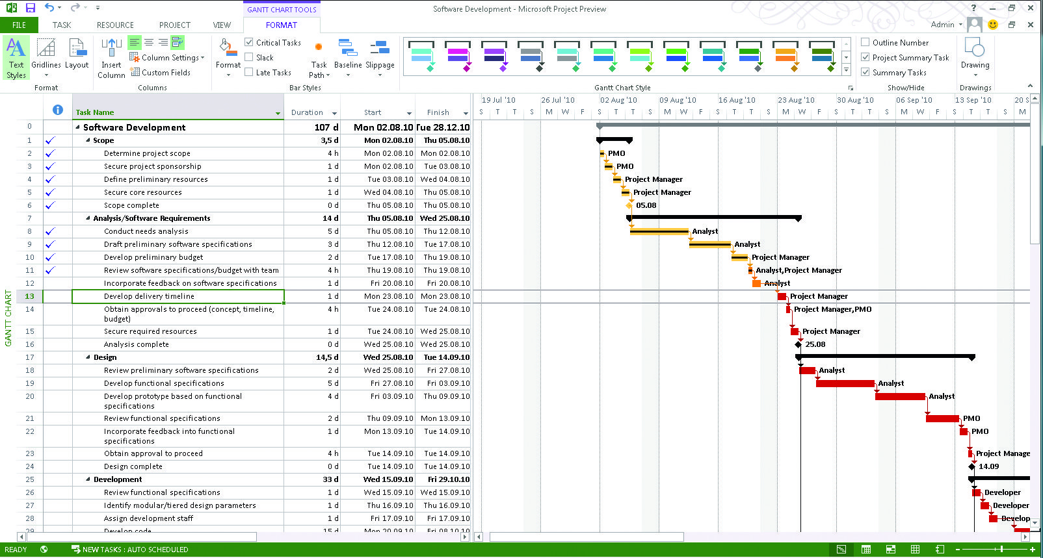

Slide 23
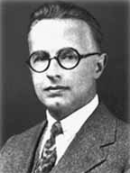
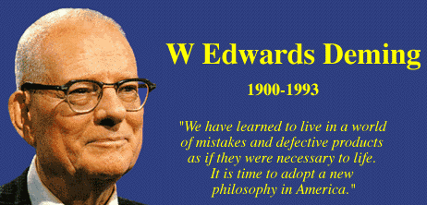
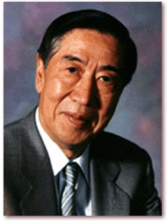
Quality control applications:
  1924: Walter Shewhart Statistical Quality Control
  1950’s: Edwards Deming Quality management
  1950’s: Genichi Taguchi Design of experiments

Slide 24
Historical Origins of OR

Slide 25
Historical origins of OR
OR stands for Operations Research.
  <Yöneylem Araştırması>
The terminology is first introduced in World War II (1939 - 1945).
OR was defined as ‘‘a scientific method of providing executive departments with a quantitative basis for decisions regarding the operations under their control.’’

Slide 26
Historical origins of OR
Quantitative Analysis during World War II
Ex1: Tests showed that aircraft painted white were on average not spotted until they were 20% closer than those painted black.
This change indicated that 30% more submarines would be attacked and sunk for the same number of sightings.

Slide 27
Historical origins of OR
Quantitative Analysis during World War II
Ex2: Other work indicated that on average if the trigger depth of aerial-delivered bombs were changed from 100 feet to 25 feet, the chance of being hit would go up.
Before the change of settings from 100 feet to 25 feet, 1% of submerged U-boats were sunk and 14% damaged. After the change, 11% sunk and 15% damaged

Slide 28
Historical origins of OR
After World War II
OR was no longer limited to only operational, but was extended to fields such as manufacturing, training, and logistics.
+
It was not bound to military scientists, and also applied to the civilian sector.

Slide 29
OR
OR is a collection of analytical methods and tools that IE uses to make better decisions to be used in real-life systems and processes or in theory.
In other words IE = OR
What are these analytical methods and tools ?

Slide 30
Operations Research (OR)
Operations Research or operational research is a discipline that deals with the application of advanced analytical methods to help making better decisions.
Employing techniques from other mathematical sciences, such as mathematical modeling, statistical analysis, and mathematical optimization, operations research arrives at optimal or near-optimal solutions to complex decision-making problems.
It is often concerned with determining a maximum (such as profit, performance, or yield) or minimum (such as loss, risk, or cost.)
Operations research overlaps with other disciplines, notably industrial engineering, operations management, and management science.

Slide 32
OR Decisions in Transportation
OR Decisions at British Airlines
Which aircrafts should they buy ?
Where should they fly ?
Which airlines should they partner with ?
How should they board big A380s ?

Slide 33
OR Decisions in Trasportation
Airbus A380 Case:
Questions:
How long will it take for an A380 to depart from an airport after it lands ?
How many staff do they require?
How many boarding doors are required ?
Solution method: Simulation – Multiple scenarios are tested at safer computer environment.
Result: Customer satisfaction ➔ profitability

Slide 34
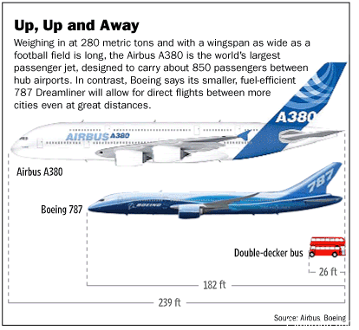

Slide 35
OR Decisions in Supply Chain
OR Decisions at ASDA:
Objective: Customers must be served on time.
Questions:
How quickly can they get the products from points of manufacture to depots or stores?
Where to build a new depot or a store?
Solution method: Route planning, modeling and analysis tools.

Slide 36
OR Decisions in Manufacturing
OR Decisions at Tata Steel:
Question:
Can they produce %20-30 more with the existing infrastructure ?
4.4 million tons of steel ➔ 5.3 million tons of steel
Objective: To decrease cost per ton (cost/ton)
Solution method: They model various scenarios at real life at computer environment.

Slide 37
OR Decisions in Manufacturing
OR Decisions at Crown Paintings:
Questions: How many different colors and variaties of paints are required ?
Objective: Minimize manufacturing costs.
Solution method: Simulation model of the facility is used.

Slide 38
Industrial Engineering
Operations Research
Management Science

Slide 39
Subfields of OR\IE
Mathematical Modelling
Optimization
Data Mining\Science
Logistics
Simulation
Quality Control
Probabilty and Statistics
Decision Support Systems
Scheduling
Financial Engineering
Game Theory
Graph Theory
Supply Chain Management
Project Management
Forecasting
…

Slide 40
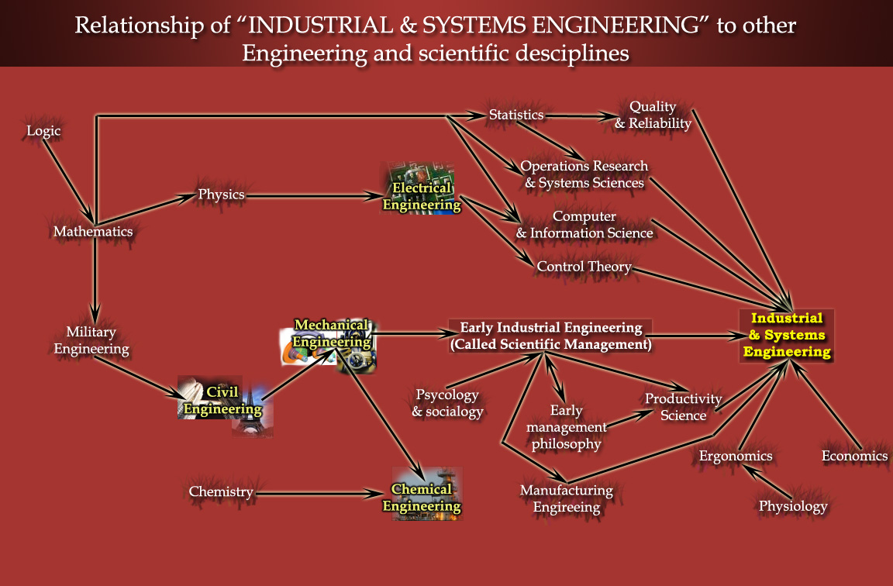

Slide 41
Definition of Science
«the intellectual and practical activity encompassing the systematic study of the structure and behaviour of the physical and natural world through observation and experiment.»

Slide 42
Is Engineering a Science ?
Answer is No.
‘‘Discovery is the essence of science. Engineers innovate solutions to real-world challenges in society. While it is true that engineering without science could be haphazard; without engineering, scientific discovery would only be an academic pursuit.’’
haphazard: gelişigüzel
pursuit: arayış, uğraş

Slide 43
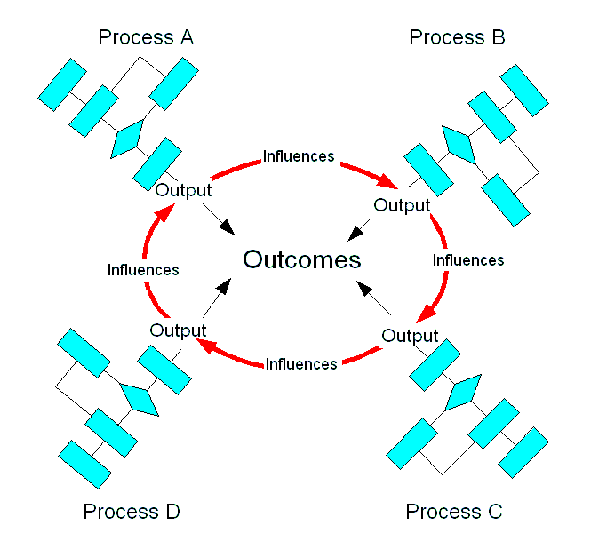
Industrial Engineering – Science of Better
Industrial engineering is a branch of engineering which deals with the optimization of complex processes or systems.
Industrial engineers figure out ways to do things better. They engineer processes and systems that improve quality and productivity.
Industrial engineers design or improve systems for the physical distribution of goods and services.
It is concerned with the development, improvement, implementation of systems or processes.
System

Slide 44
Other Definitions for IE\OR
OR is applying appropriate analytical methods to make better decisions.
IIE: ‘‘Industrial Engineering is concerned with the design, improvement, and installation of integrated systems of people, materials, information, equipment and energy. It draws upon specialized knowledge and skill in the mathematical, physical, and social sciences together with the principles and methods of engineering analysis and design to specify, predict, and evaluate the results to be obtained from such system.’’

Slide 45
Industrial Engineering – Science of Better
optimization is selecting the best solution satisfying some criteria or constraints from a set of available alternatives.

Slide 46
Career Opportunities

Slide 47
Historical Landmarks Introduction to Robust Design and Use of Taguchi Method
Notes:
What is Isp a function of?

Slide 48
Genichi Taguchi
In the 1980s, Genichi Taguchi [Taguchi and Wu (1980), Taguchi (1986, 1987)] introduced new ideas on quality improvement in the United States. He proposed an approach he called parameter design for reducing variation in products and processes. His methods and phil- osophy generated considerable interest among quality engineers and statisticians. During the 1980s his methodology gained usage at AT&T Bell Laboratories, Ford Motor Company, Xerox, and many other prominent organizations.

Slide 49
Two factors
Controllable factors are called control factors (like decision variables in optimization)
Noise factors are uncontrollable in the design of the product or in the normal operation of the process.

Slide 50
What is Robust Design
Robust design: a design whose performance is insensitive to variations.
Example: We want to pick x to maximize F
Simply doing a trade study to optimize the value of F would lead the designer to pick this point
F
What if I pick this point instead?
This means that values of F as low as this can be expected!
x

Slide 51
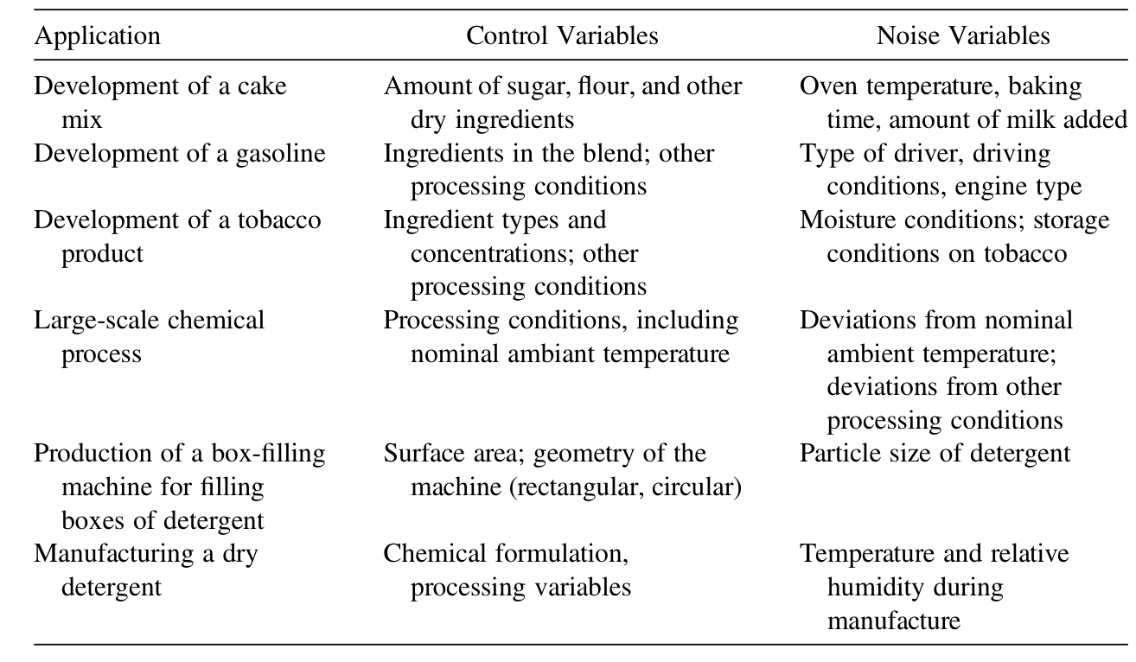
Two factors: Examples

Slide 52
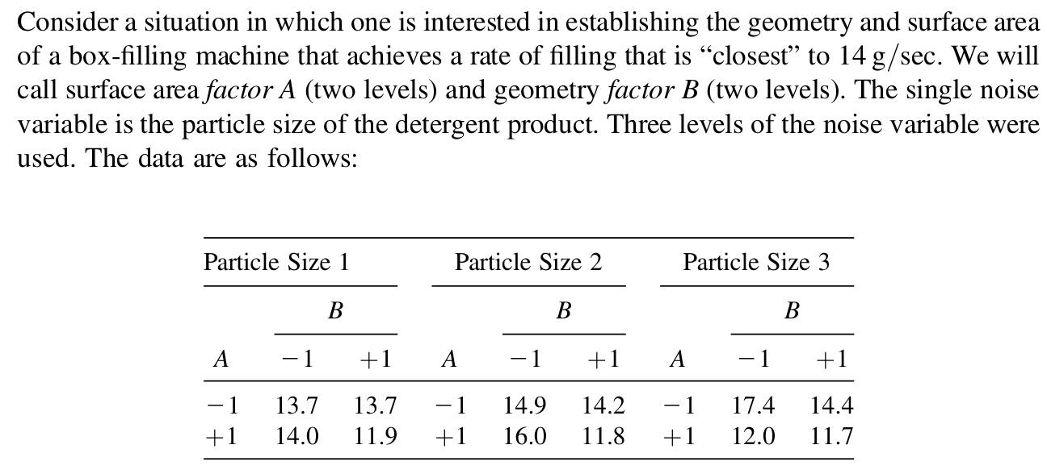
An example of robust product design

Slide 53
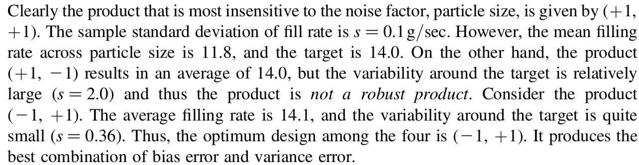
An example of robust product design

Slide 54
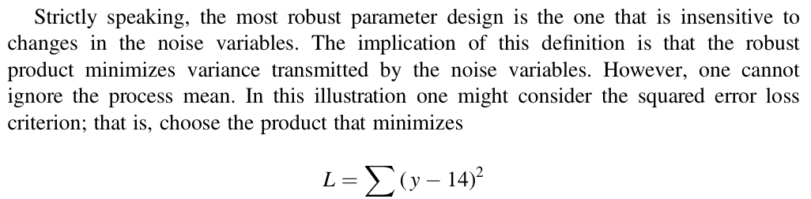
An example of robust product design

Slide 55
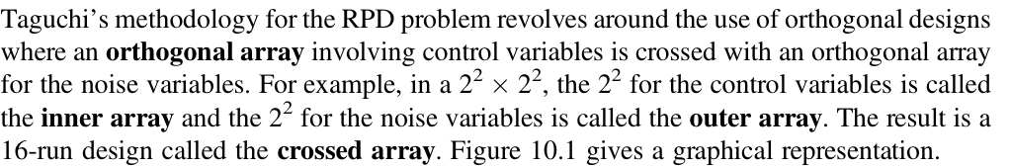
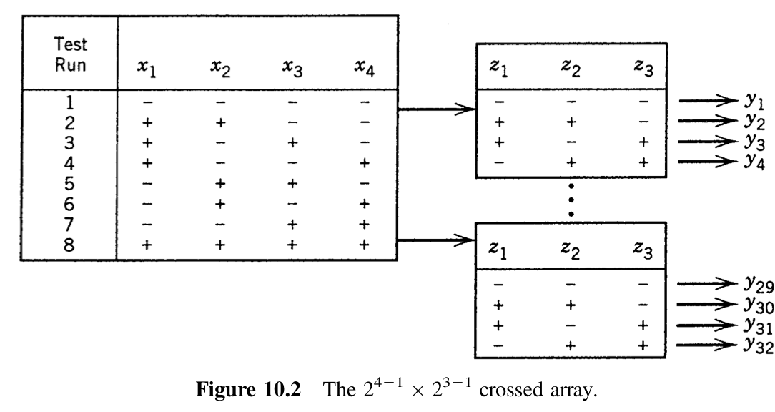
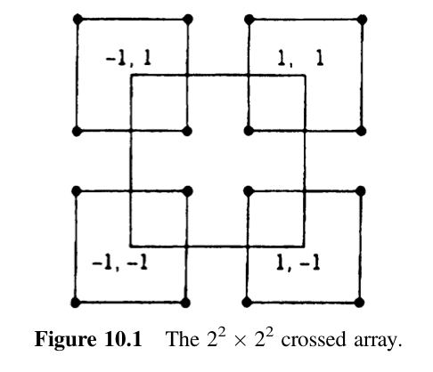
Crossed Arrays and Signal-to-Noise Ratios

Slide 56
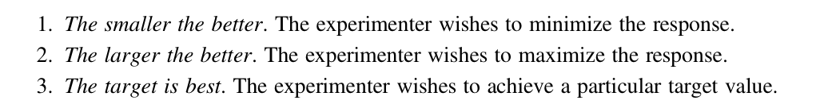
Crossed Arrays and Signal-to-Noise Ratios
Choice depends on the goal of the experiment:

Slide 57
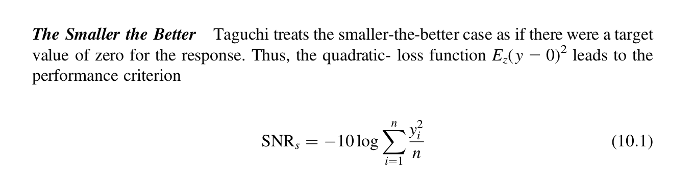
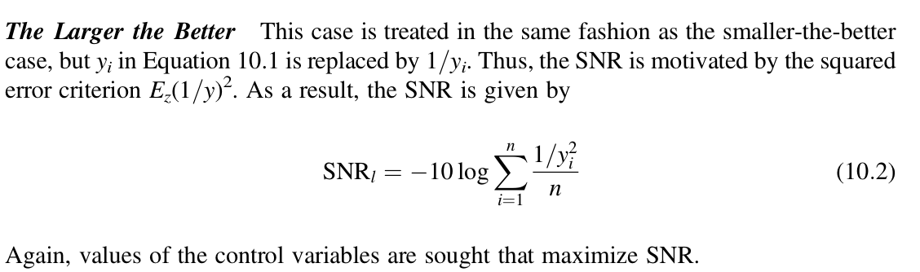
Crossed Arrays and Signal-to-Noise Ratios

Slide 58
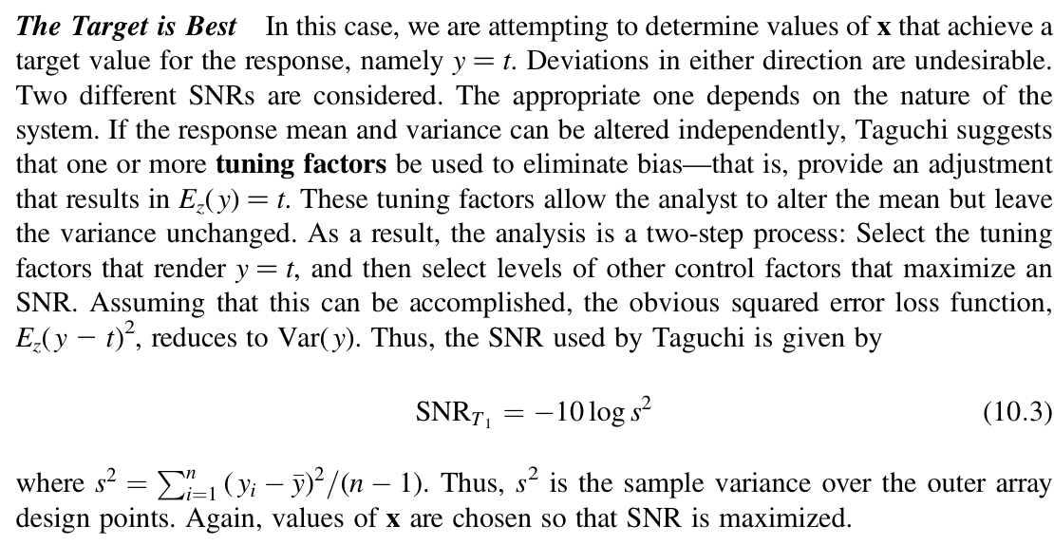
Crossed Arrays and Signal-to-Noise Ratios

Slide 59
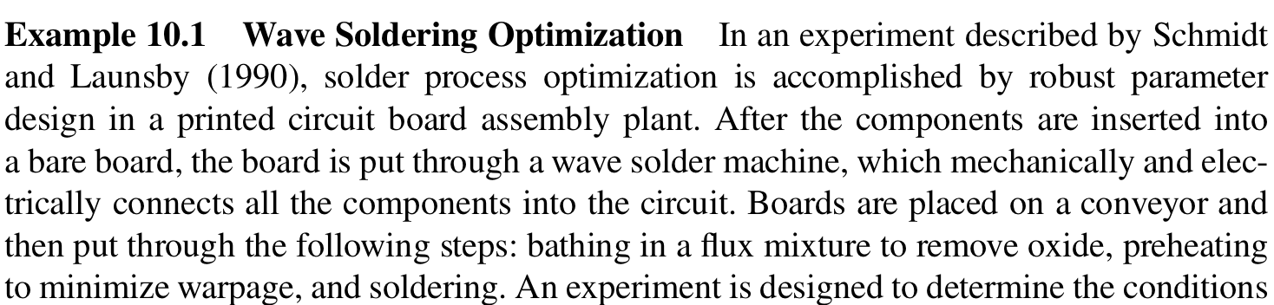
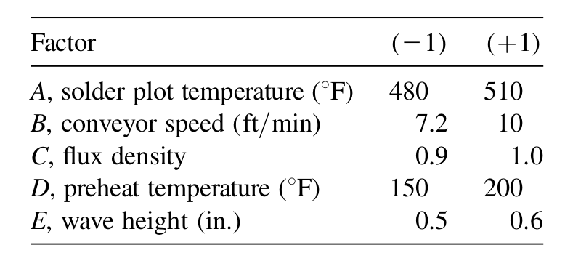
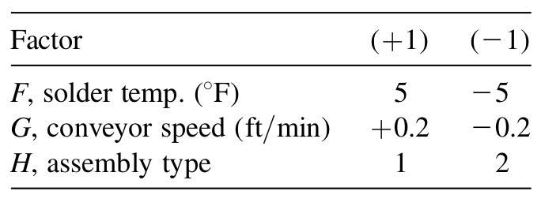
Example

Slide 60
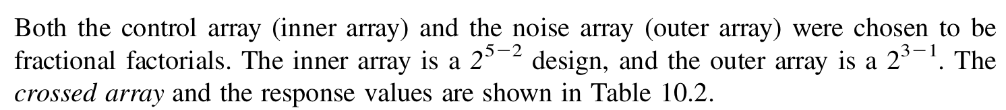
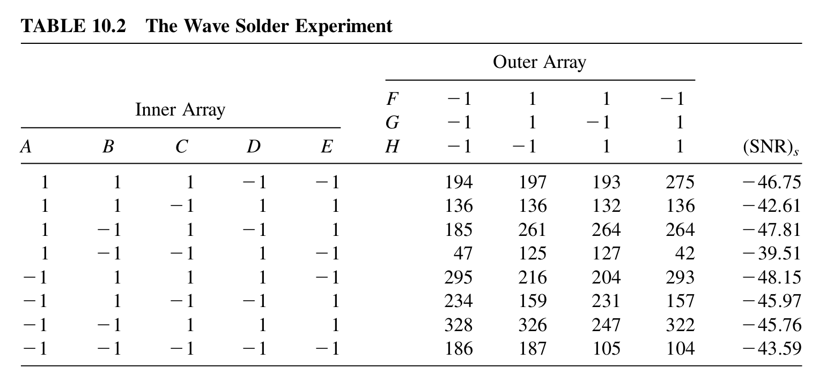
Example

Slide 61
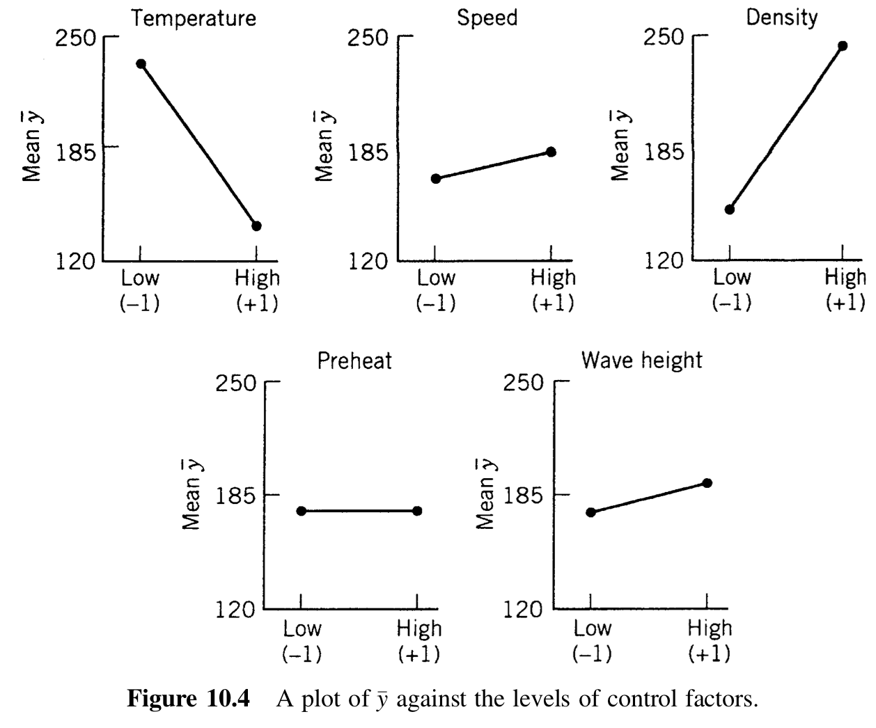
Example

Slide 62
What is Robust Design
The robust design process is frequently formalized through “six-sigma” approaches (or lean/kaizen approaches)
Six Sigma is a business improvement methodology developed at Motorola in 1986 aimed at defect reduction in manufacturing.
Numerous aerospace organizations that have implemented these systems, including:
  Department of Defense
  NASA
  Boeing
  Northrop Grumman

Slide 63
Taguchi Method for Robust Design
Systemized statistical approach to product and process improvement developed by Dr. G. Taguchi
Approach emphasizes moving quality upstream to the design phase
Based on the notion that minimizing variation is the primary means of improving quality
Special attention is given to designing systems such that their performance is insensitive to environmental changes

Slide 64
The Basic Idea Behind Robust Design
ROBUSTNESS ≡ QUALITY
Reduce
Variability
Increase
Quality
Reduce
Cost

Slide 65
Any Deviation is Bad: Loss Functions
The traditional view states that there is no loss in quality (and therefore value) as long as the product performance is within some tolerance of the target value.
In Robust Design, any deviation from the target performance is considered a loss in quality → the goal is to minimize this loss.
Loss = k(x-x_{T})²
Loss
No
Loss
Loss
x_{LSL}
x_{T}
x_{USL}
x
x_{LSL}
x_{T}
x_{USL}
x
x_{T} = Target Value
x_{LSL} = Lower Specification Limit
x_{USL} = Upper Specification Limit

Slide 66
Overview of Taguchi Parameter Design Method
1. Brainstorming
2. Identify Design Parameters and Noise Factors
Design Parameters: Variables under your control
Noise Factors: Variables you cannot control or
variables that are too expensive
to control
3. Construct Design of Experiments (DOEs)
Ideally, you would like to investigate all possible combinations of design parameters and noise factors and then pick the best design parameters. Unfortunately, cost and schedule constraints frequently prevent us from performing this many test cases – this is where DOEs come in!
4. Perform Experiments
5. Analyze Results

Slide 67
Design of Experiments (DOE)
Design of Experiments: An information gathering exercise. DOE is a structured method for determining the relationship between process inputs and process outputs.
Here, our objective is to intelligently choose the information we gather so that we can determine the relationship between the inputs and outputs with the least amount of effort
L₉(3⁴) Orthogonal Array
Exp. Num | Variables
 | X₁ | X₂ | X₃ | X₄
1 | 1 | 1 | 1 | 1
2 | 1 | 2 | 2 | 2
3 | 1 | 3 | 3 | 3
4 | 2 | 1 | 2 | 3
5 | 2 | 2 | 3 | 1
6 | 2 | 3 | 1 | 2
7 | 3 | 1 | 3 | 2
8 | 3 | 2 | 1 | 3
9 | 3 | 3 | 2 | 1
L₄(2³) Orthogonal Array
Exp. Num | Variables
 | X₁ | X₂ | X₃
1 | 1 | 1 | 1
2 | 1 | 2 | 2
3 | 2 | 1 | 2
4 | 2 | 2 | 1
Number of Variable Levels
Number of Variables
L₄(2³)
Number of Experiments
Num of Experiments must be ≥ system degrees-of-freedom: DOF = 1 + (# variables)*(# of levels – 1)

Slide 68
Inner & Outer Arrays
N₃ | 1 | 2 | 2 | 1
N₂ | 1 | 2 | 1 | 2
N₁ | 1 | 1 | 2 | 2
 | 1 | 2 | 3 | 4
Design Parameters
 | X₁ | X₂ | X₃ | X₄
1 | 1 | 1 | 1 | 1
2 | 1 | 2 | 2 | 2
3 | 1 | 3 | 3 | 3
4 | 2 | 1 | 2 | 3
5 | 2 | 2 | 3 | 1
6 | 2 | 3 | 1 | 2
7 | 3 | 1 | 3 | 2
8 | 3 | 2 | 1 | 3
9 | 3 | 3 | 2 | 1
Experiment Number
Performance Characteristic evaluated at the specified design parameter and noise factor values
Noise
y₁₁ = f {X₁(1), X₂(1),
X₃(1), X₄(1),
N₁(1), N₂(1), N₃(1)}
Experiment Num
y₅₂ = f {X₁(2), X₂(2),
X₃(3), X₄(1),
N₁(1), N₂(2), N₃(2)}
Inner Array – design parameter matrix
Outer Array – noise factor matrix

Slide 69
Processing the Results (1 of 2)
Noise
Design Parameters
Experiment Num
Experiment Number
Performance Characteristic evaluated at the specified design parameter and noise factor values
Compute signal-to-noise (S/N) for each row
Minimizing performance
characteristic
Maximizing performance
characteristic
Inner Array – design parameter matrix
Outer Array – noise factor matrix

Slide 70
Processing the Results (2 of 2)
Isolate the instances of each design parameter at each level and average the corresponding S/N values.
Design Parameters
 | X₁ | X₂ | X₃ | X₄
1 | 1 | 1 | 1 | 1 | S/N₁
2 | 1 | 2 | 2 | 2 | S/N₂
3 | 1 | 3 | 3 | 3 | S/N₃
4 | 2 | 1 | 2 | 3 | S/N₄
5 | 2 | 2 | 3 | 1 | S/N₅
6 | 2 | 3 | 1 | 2 | S/N₆
7 | 3 | 1 | 3 | 2 | S/N₇
8 | 3 | 2 | 1 | 3 | S/N₈
9 | 3 | 3 | 2 | 1 | S/N₉
Experiment Number
Signal-to-Noise (S/N)
X₂ is at level 1 in experiments 1, 4, & 7

Slide 71
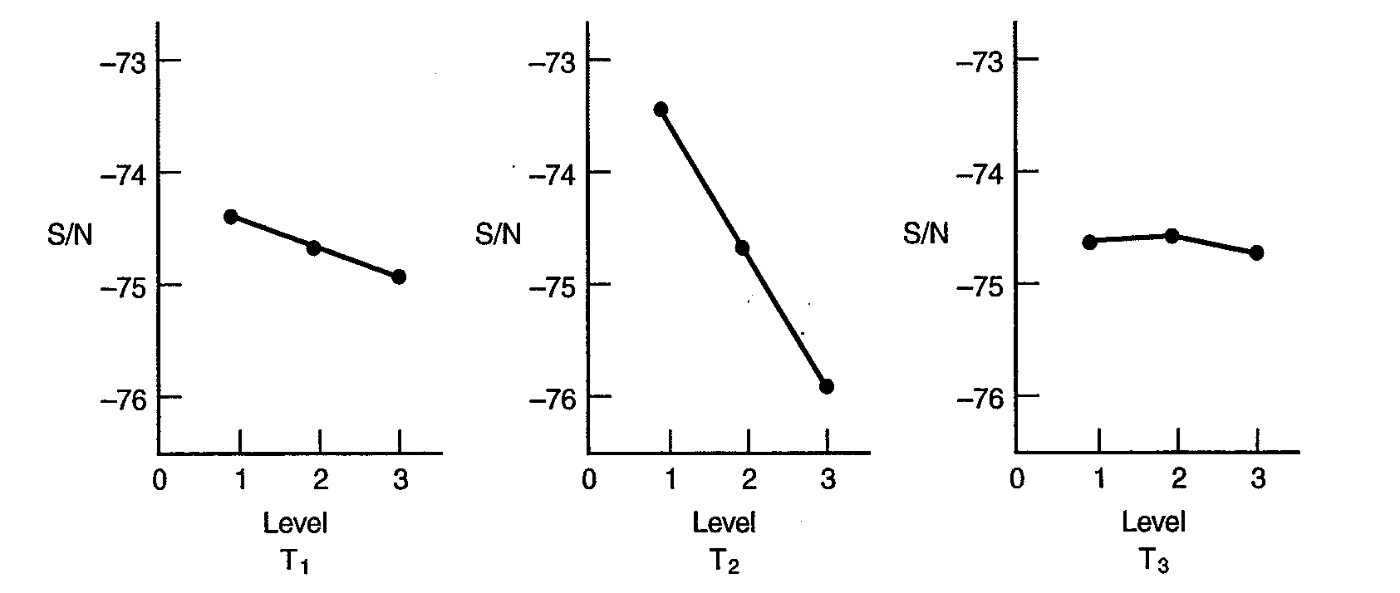
Visualizing the Results
Plot average S/N for each design parameter
ALWAYS aim to maximize S/N
In this example, these are the best cases.

Slide 72
Conclusions on RPD
Decisions made early in the design process cost very little in terms of the overall product cost but have a major effect on the cost of the product
Quality cannot be built into a product unless it is designed into it in the beginning
Robust design methodologies provide a way for the designer to develop a system that is (relatively) insensitive variations

Slide 73
Optimization under Uncertainty and
Robust Optimization

Slide 74
Optimization under uncertainty
Mathematical optimization problems often have uncertainty in problem parameters because of measurement/rounding, estimation/forecasting, or implementation errors.
Measurement/rounding errors are often caused when an actual measurement is rounded to a nearest value according to a rule, e.g., the nearest tenth or hundredth, or when the actual value of the parameter cannot be measured with a high precision as it appears in reality. For example, if the reported parameter value is 1.5 according to the nearest tenth, then the actual value can be anywhere between 1.45 and 1.55, i.e., it is uncertain.

Slide 75
Optimization under uncertainty
Estimation/forecasting errors come from the lack of true knowledge about the problem parameter or the impossibility to estimate the true characteristics of the actual data. For example, demand and cost parameters are often subject to such estimation/forecasting errors.
Implementation errors are often caused by “ugly” reals that can be hardly implemented with the same precision in reality. For example, suppose the optimal voltage in a circuit, that is calculated by an optimization tool, is 3.81231541.

Slide 76
Methods of Optimization under uncertainty
Stochastic Programming
Robust Optimization
What is the main difference between two methods?
  The way they model uncertainty
  Robust optimization adopts uncertainty set
  Stochastic programming uses probability distributions

Slide 77
Advantages of Robust Optimization
Easy to implement and solve
Can work with limited data
Tractable
Has many applications in real-life

Slide 78
Disadvantages of Robust Optimization
Worst-case oriented
When distributional information is available stochastic programming yields better solutions

Slide 79


Deriving the RC for the box uncertainty set
Lets compare the two formulations (namely, nominal and robust models)
$$\max{ 4x_{1}+2x_{2}} \\ s.t. 2x_{1}+x_{2}≤100 \\ x_{1}+x_{2}≤80 \\ x_{1}≥40 \\ x_{1,2}≥0$$
$$\max{ 4x_{1}+2x_{2}} \\ s.t. 2{.5x}_{1}+{2x}_{2}≤100 \\ { x}_{1}+x_{2}≤80 \\ { x}_{1}≥40 \\ x_{1,2}≥0$$

Slide 80

Deriving the RC for the ellipsoid uncertainty set
What if the uncertainty set was an ellipsoid:
  Say ${\left(a_{1}−2\right)}^{2}+{\left(a_{2}−1\right)}^{2}≤1$
  Draw it!
  Lets translate it to something easier:
    $2x_{1}+ζ_{1}x_{1}+x_{2}+ζ_{2}x_{2}≤100$
  Derive the RC

Slide 81

The Resulting RC
The final RC is given as follows:
$$\max{ 4x_{1}+2x_{2}} \\ s.t. 2x_{1}+x_{2}+\sqrt{x_{1}^{2}+x_{2}^{2}}≤100 \\ x_{1}+x_{2}≤80 \\ x_{1,2}≥0$$

Slide 82
Nominal vs robust solution performance comparison for box uncertainty
The nominal problem yields the alternative optimal solutions (20,60), (40,20) and (30,40) with objective function value of 200.
The robust problem yields the optimal solution (40,0) with objective function value of 160.
If we implement the nominal optimal solutions to robust problem.
It will be infeasible. Lets see!

Slide 83

Infeasibility of nominal solution
Left-hand side values for:
  110 for (20,60)
  120 for (40,20)
  also see: 115 for (30,40)
Notice that nominal solutions that
yield the same performance can have
different levels of infeasibilities in the
worst-case.
$$\max{ 4x_{1}+2x_{2}} \\ s.t. 2{.5x}_{1}+{2x}_{2}≤100 \\ { x}_{1}+x_{2}≤80 \\ { x}_{1}≥40 \\ x_{1,2}≥0$$

Slide 84
Tradeoff between optimality and feasibility
Optimization based on nominal values often lead to severe infeasibilities
Notice that even though nominal solutions yield an objetive function value that is %25 higher than that of robust they are infeasible
How should we compare to solutions???

Slide 85
A fair comparison approach: Simulation
The best way to compare two solutions optimization solutions under uncertainty is via Monte Carlo Simulation.

Slide 86
Two Applications from Practice

Slide 87
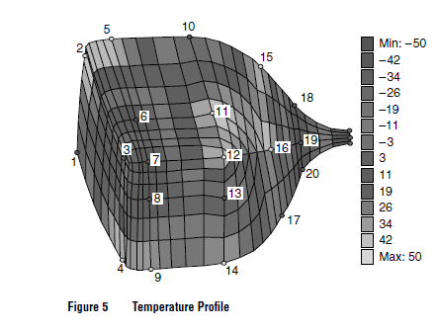
An application of OR/IE
Robust TV tube design

Slide 88
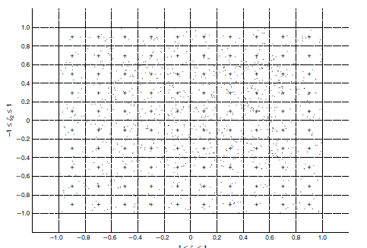
Data Analysis

Slide 89
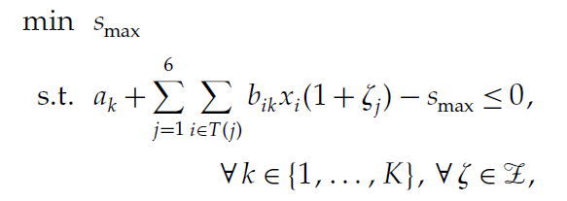
Matematical Modeling

Slide 90
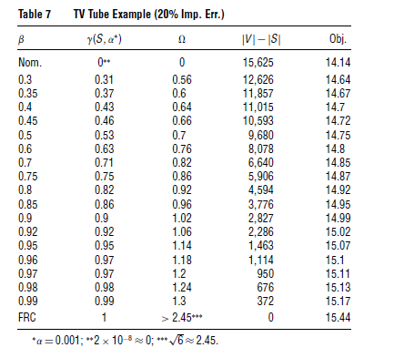
Solving & Analyzing Outcomes

Slide 91
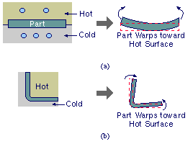

Slide 93
